Slide 1
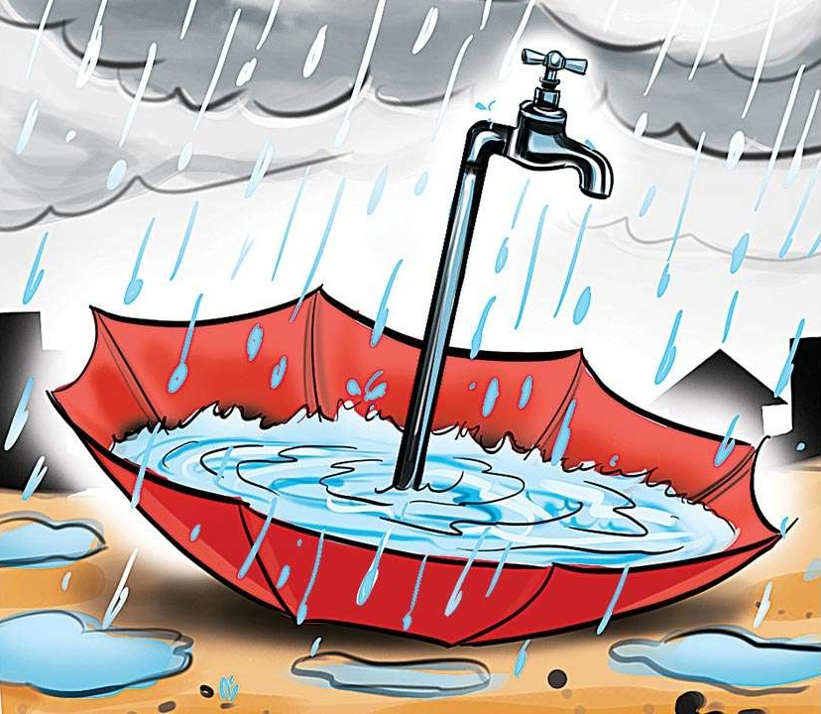
PRESENTATION ON RAIN WATER HARVESTING
BY
M.PAVAN KUMAR REDDY
122010402035
ECE-B

Slide 2
It is a type of water harvesting
It can be defined as the system of collection and concentration of rain water
Its run off and its productive use for
1. Irrigation of annual crops pastures and trees
2. Domestic and live stock consumption
3.Ground water recharge

Slide 3
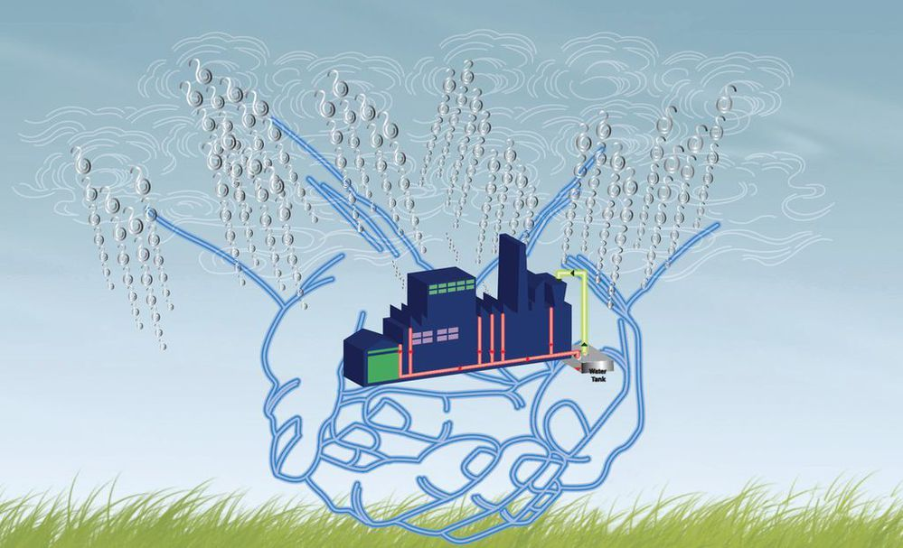
Rain water harvesting is essential because:-
Surface water is inadequate to meet our demand and we have to depend on ground water
Due to rapid urbanization , infiltration of rain water into the sub-soil has decreased drastically and recharging of ground water has diminished

Slide 4
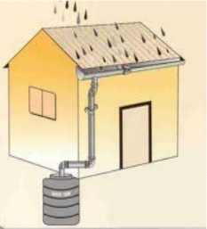
Rain water can be harvested in a variety of ways
1.Directiy from roof tops and stored
in tanks
2.Water from the flooded rivers can be stored in small ponds
3.Collection and transfer of rain water into percolation tanks so as to facilitate discharge into ground

Slide 5
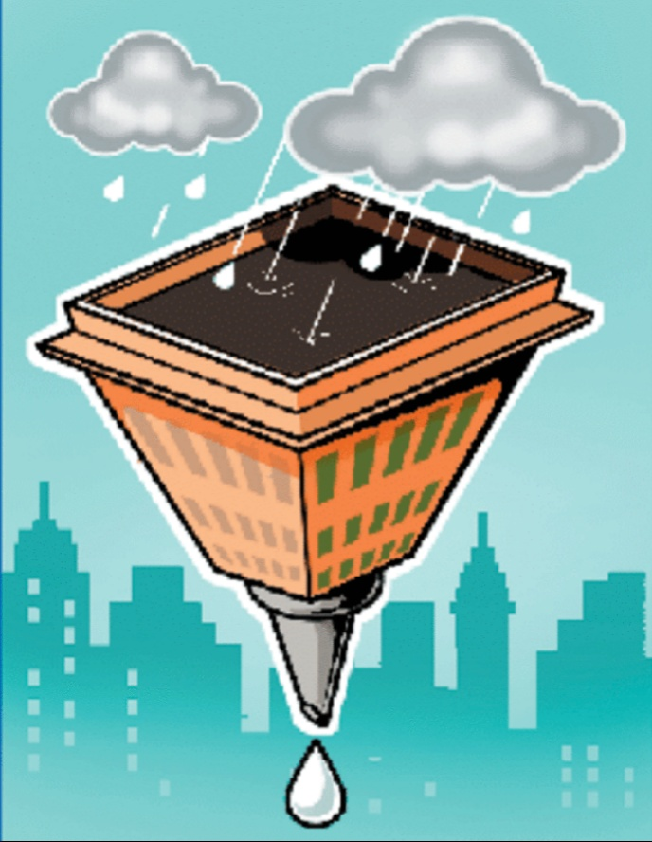
ADVANTAGES OF RAIN WATER HARVESTING
Environment friendly
Migrates the effects of drought
Reduces the soil erosion
Helps in reducing water and electricity bills
Reduces the runoff

Slide 6
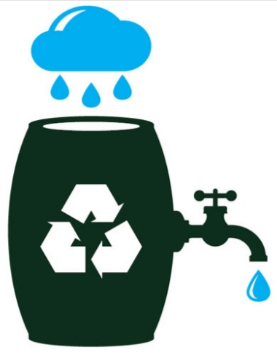
Rain water harvesting plays an important role in agriculture
Useful for urban areas
It is important to save the water for the future.
Thus it is important to improve rain water harvesting through technical and financial prospects.

Slide 7
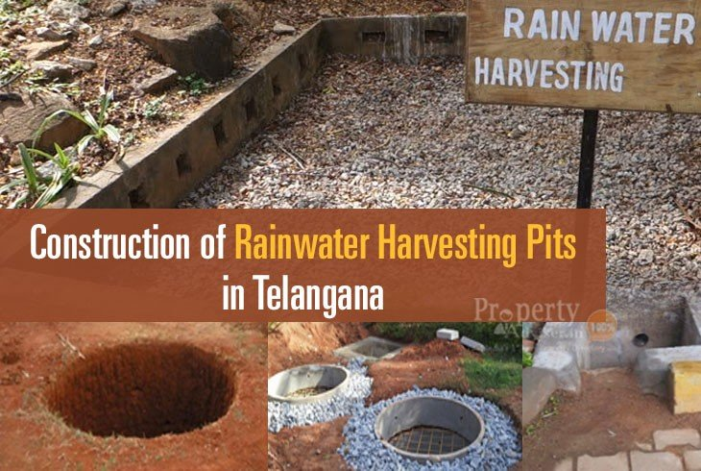
URBAN MODLE OF RWH
More modernized system of rain water harvesting
The main components of the urban model are:-
1.Roof catchment
2.Gutters
3.Down pipe
4.First flush pipe
5.Filter unit
6.Storage tank
7.Collection pit

Slide 8
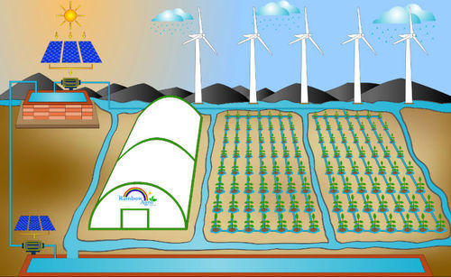
Rain water harvesting can be used for watering gardens in our homes and crop plants in agricultural fields.
It can be used to divert heavy rainfall from reaching agricultural lands , there by protecting crop plants from getting damaged
It provide an alternative supply during water restrictions and help maintain a green ,healthy garden.

Slide 9
DISADVANTAGES
If tanks are not maintained properly then it can cause various problems in terms of algal or bacterial growth.
Tanks if not constructed properly might result in leakages.
Metal tanks may also lead to problems such as corrosion harming the water quantity.
All these factors might prove harmful and result in various kinds of health issues.

Slide 10
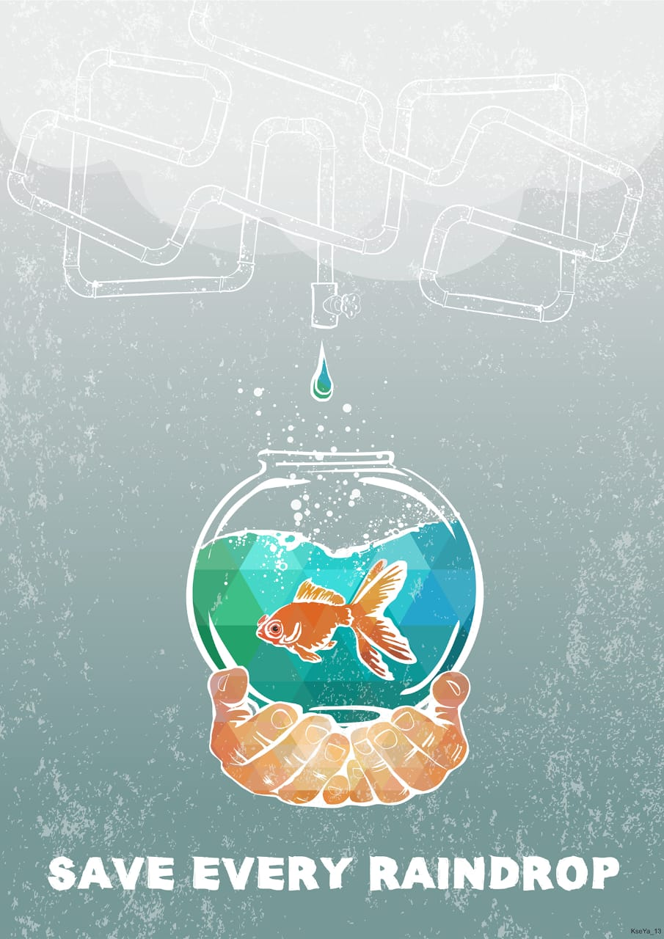
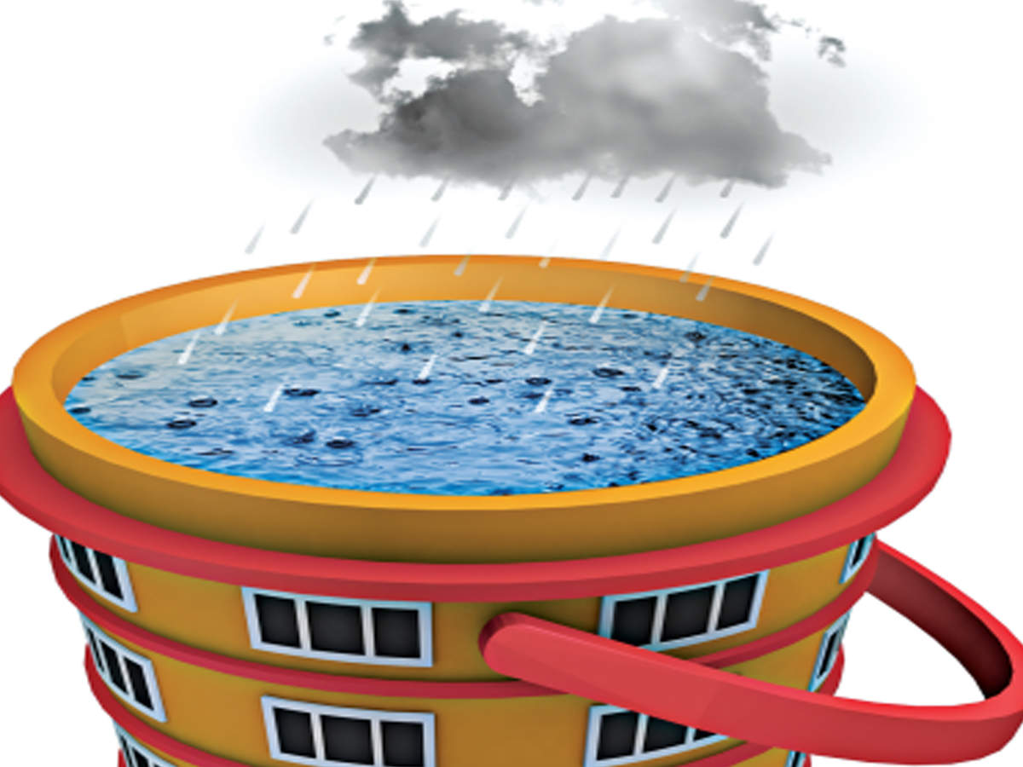
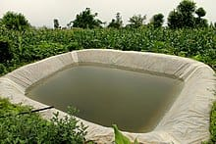
THANK YOU

